Slide 1

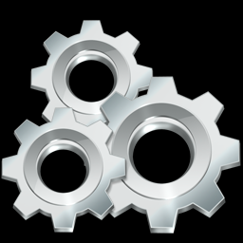
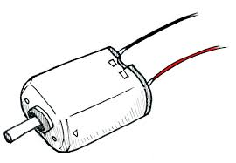
GEARS AND MOTORS

Slide 2
GEARS
A Gear is a rotating machine element which are used to transmit Torque. They have cut teeth which mesh with another gear
Gears have the ability to change the speed ,torque and the direction of power source ,thus creating a mechanical advantage through their gear ratio

Slide 3
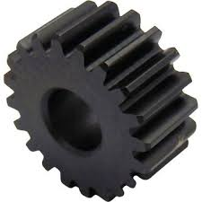
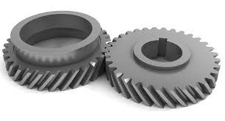
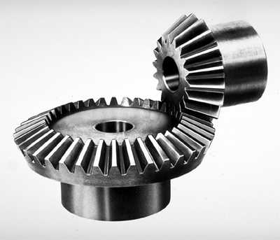
TYPES OF Gear
SPUR GEAR Gears having cylindrical pitch surfaces are called cylindrical gears. It has a tooth line which is straight and parallel to the shaft.
HELICAL GEARS are used with parallel shafts similar to spur gears and are cylindrical gears with winding tooth lines. They have better teeth meshing than spur gears and have superior quietness and can transmit higher loads.
BEVEL GEARS have a cone shaped appearance and are used to transmit force between two shafts which intersect at one point

Slide 4
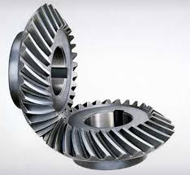
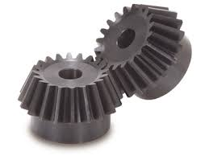
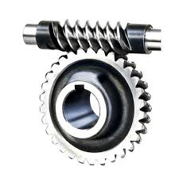
SPIRAL BEVEL GEARS are bevel gears with curved tooth lines. Due to higher tooth contact ratio, they are superior to straight bevel gears in efficiency, strength, vibration and noise
MITER GEARS are bevel gears with a speed ratio of 1. They are used to change the direction of power transmission without changing speed.
WORM GEAR A screw shape cut on a shaft is the worm, the mating gear is the worm wheel, and together on non-intersecting shafts is called a worm gear.

Slide 5
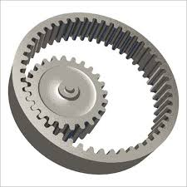
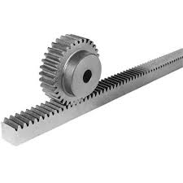
INTERNAL GEARS have teeth cut on the inside of cylinders or cones and are paired with external gears. The main use of internal gears are for planetary gear drives and gear type shaft couplings.
RACK AND PINION same sized and shaped teeth cut at equal distances along a flat surface or a straight rod is called a gear rack. By meshing with a cylindrical gear pinion, it converts rotational motion into linear motion.

Slide 6
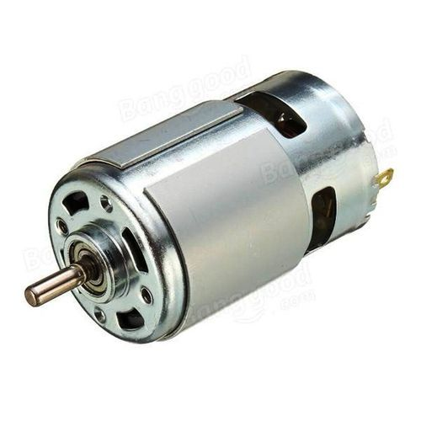
MOTORS
A motor or an engine is a device that converts any form of energy into mechanical energy, like IC engines, DC mototrs etc..

Slide 7
ELECTRICAL MOTORS
An electric motor is an electrical machine that converts electrical energy into mechanical energy. Most electric motors operate through the interaction between the motor's magnetic field and winding currents to generate force in the form of rotation

Slide 8
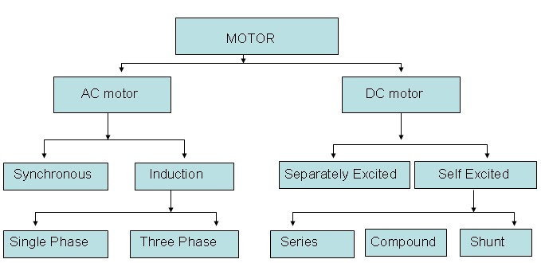
CLASSIFICATION OF MOTORS

Slide 9
DC MOTORS
A dc motor is any of a class of rotary electrical machines that converts direct current electrical energy into mechanical energy. The most common types rely on the forces produced by magnetic fields.
Its operation is based on the principle that when a current-carrying conductor is placed in a magnetic field, it experiences a mechanical force.

Slide 10
Working of a Dc motor

Slide 11
Pros –dc motor
DC motor offers the wide range of speed control both above and below the rated speeds.
High starting torque. Therefore dc series motors are used in the applications such as in electric trains and cranes.
Accurate steep less speed with constant torque
Quick starting, stopping, reversing and acceleration

Slide 12
Cons – dc motor
High initial cost
Increased operation and maintenance cost due to presence of commutator and brush gear
Cannot operate in explosive and hazard conditions due to sparking occur at brush

Slide 13
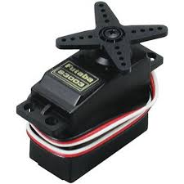
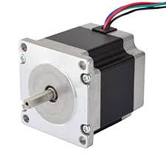
There are two special type motors used in robotics
Servo Motors
Stepper Motors

Slide 14
Servo motors
A servomotor is a rotary actuator or linear actuator that allows for precise control of angular or linear position, velocity and acceleration.
A servomotor uses position feedback to control its motion and final position. The input to its control is a signal (either analog or digital) representing the position commanded for the output shaft.

Slide 15
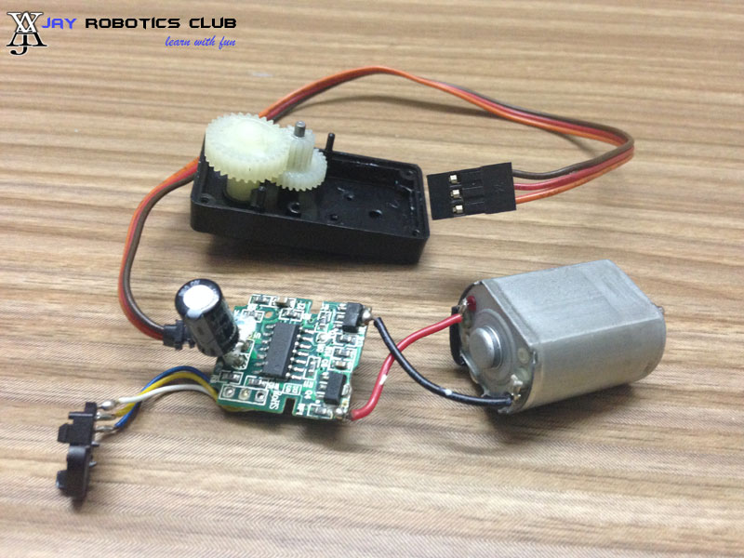
A DC servo motor is an assembly of four separate components , namely
DC motor
Gear assembly
Position sensing device
Control circuit

Slide 16
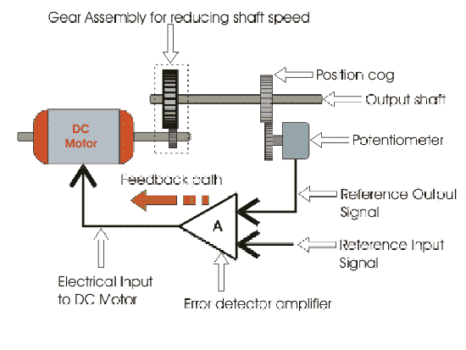

Slide 18
Stepper motor
A Stepper motor or step motor or stepping motor is a Brushless DC electric motor that divides a full rotation into a number of equal steps. The motor's position can then be commanded to move and hold at one of these steps without any position sensor for feedback

Slide 19
Working of a Stepper motor

Slide 20
servo motor vs stepper motor
SERVO MOTER | STEPPER MOTOR
OPERATE IN A CLOSED LOOP-IT HAS AN INTERNAL FEEDBACK | OPERATE IN AN OPEN LOOP-NO FEEDBACK AND THUS MORE PRONE TO ERROR
MAINTAINS THE TORQUE IN HIGH ROTATIONAL SPEEDS | LOSES TORQUE IN HIGH ROTATIONAL SPEEDS
HIGH POWER TO WEIGHT RATIO | SMALL POWER TO WEIGHT RATIO
TYPICALLY HAS 4 TO 12 POLES | TYPICALLY HAS 50 TO 100 POLES
EXPENSIVE | CHEAP COMPARED TO SERVOs

